Slide 1
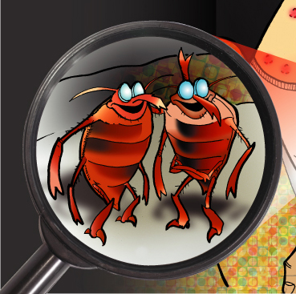
Bed Bug
Resources
Jessica Isidro
Program Coordinator
Provincial Bed Bug Strategy

Slide 2
Overview
Available Manitoba Government Resources and Programs
Written Communication Materials
Bed Bug Videos
Non-Profit Community Grants Program
Low-Cost Preventive Materials Program
Bug N’ Scrub Program
Provincial Bed Bug Phone Inquiry
Line/E-mail

Slide 3
Available Manitoba Government
Resources and Programs
Written Materials Available:
Bed Bugs Fact Sheets (Available in 17 different languages)
Myths & Facts About Bed Bugs
Residential Tenancies Branch Bed Bug Info Sheets
Rights & Responsibilities of Landlords and Tenants
Bed Bug Information for Landlords and Property Managers
Bed Bug Removal – Information for Tenants
What to do… If You Live in a Building with Bed Bugs?
Other Written Materials:
“Billy the Bed Bug” Brochures
Landlord/Property Manager Informational Posters
Bed Bug Hotline/E-mail Info Contact Cards
Do Not Self Treat for Bed Bugs Info Magnets
Manitoba Hotel Association – Watch for Bed Bugs Resource Tool

Slide 4
Bed Bug Videos
All About Bed Bugs
How to Prevent Bed Bugs
How to Identify Bed Bugs
What to do if You Find Bed Bugs?
Dealing With Bed Bugs (14 Different Languages)
http://www.gov.mb.ca/bedbugs/videos.html

Slide 5
Non-Profit Community Grants Program
The Bed Bug Grant Program is an initiative designed to provide assistance to community organizations on bedbug education, treatment, management and prevention
Community-based, non-profit organizations are eligible to apply for financial assistance in the form of a grant. (e.g. emergency housing shelters, non-government social services programs etc.)
Qualified organizations will be eligible to recover costs related to bedbug treatment, prevention and education to a maximum of $2,000.00/per year

Slide 6
Non-Profit Community Grants Program
What types of bedbug treatment, prevention and education activities are eligible for grant funding?
→ Inspection or treatment done by a professional exterminator
Purchase of non-chemical controls (e.g. mattress covers, storage containers, monitoring traps and double-sided sticky tape)
Purchase or rental of equipment utilized for bedbug prevention and control. (e.g. dryers, vacuums and spot steamers.)
Organizations can apply for this grant by downloading an application form at www.manitoba.ca/bedbugs or by calling the bedbug hotline toll-free at 1-855-3MB-BUGS (1-855-362-2847)

Slide 7
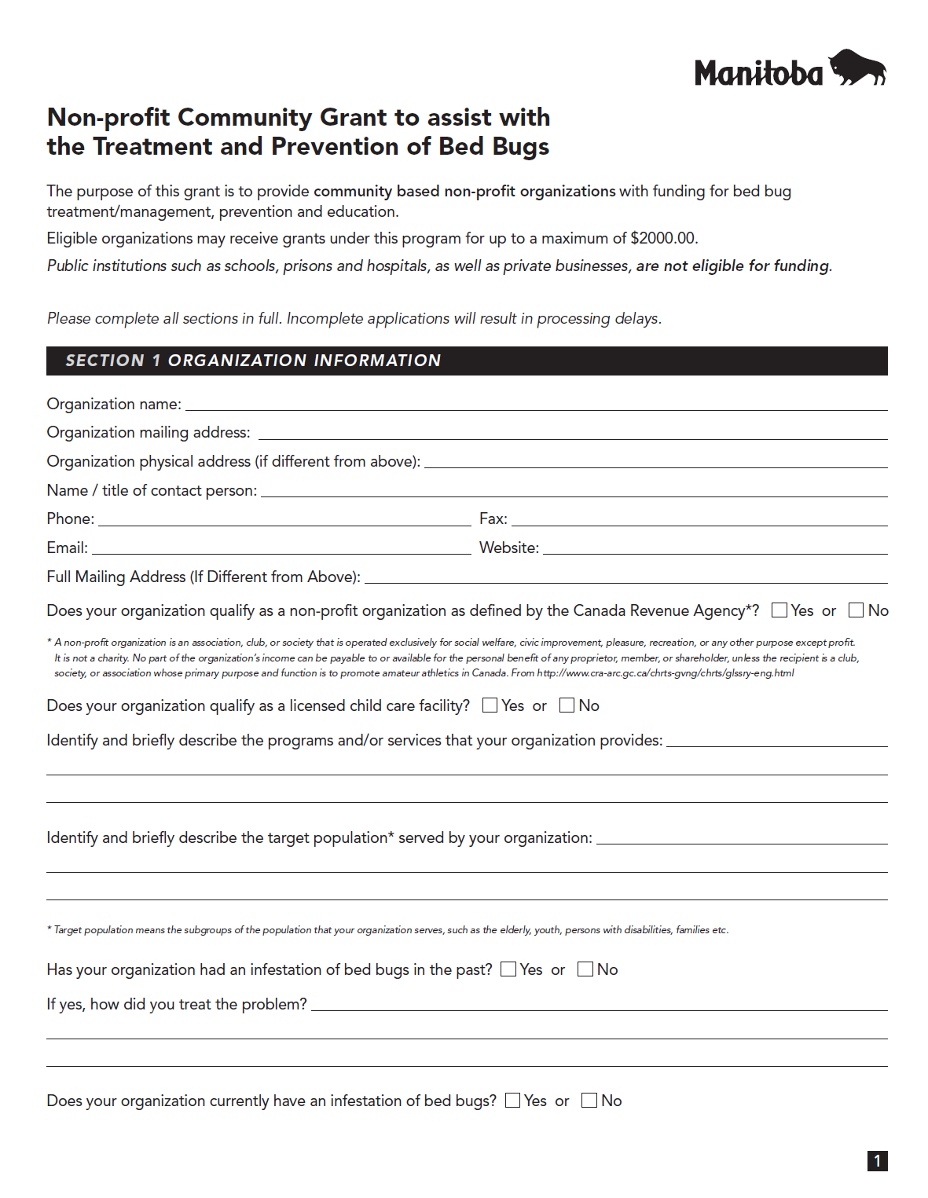

Slide 8
Low-Cost Preventive Materials Program
The program offers a wide variety of specialized bedbug specific materials to qualifying organizations at attractive prices to combat bedbug infestations
Materials include bedbug-proof mattress and box-spring covers, insect monitors and record keepers, insect interceptor traps, dissolvable laundry bags, bedbug warning stickers, educational handouts and clear-view bedbug monitors
The program is available to the Manitoba Camping Association, the Manitoba Professional Property Managers Association and Non-Profit Organizations
Store Front where the general public are able to purchase prevention materials individually at low-cost will be opening sometime in early 2013. (located at Neechi Commons)

Slide 9
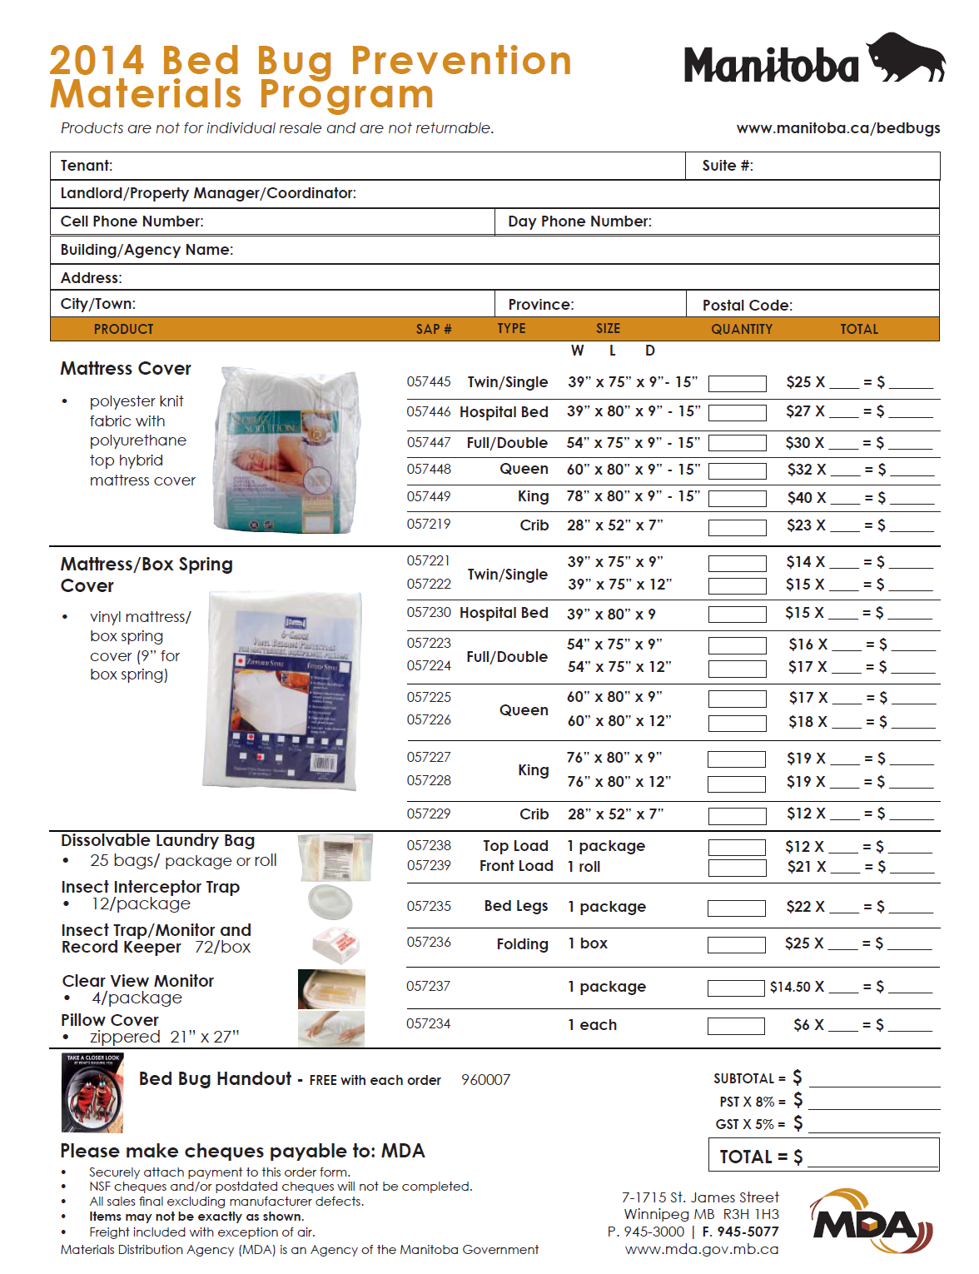

Slide 10
Low-Cost Preventive Bed Bug Materials Store Front – Neechi Commons
Telephone: (204) 949-1338
865 Main Street

Slide 11
Bug N’ Scrub Program (Winnipeg & Brandon Only)
For vulnerable persons who need help due to limitations that prevent them from preparing their home, the Bug N Scrub program provides a variety of preparation services such as moving furniture, general cleaning, laundry service, and reducing and removing clutter.
The Bug N Scrub team also returns to the home or apartment after treatment is complete to put things back in order
Vulnerable persons that need service must be referred by qualified organizations or individuals that have first- hand knowledge of the needs of the applicant
Referrals are made by completing an assessment form or by calling the toll-free Bed Bug Hotline at 1-855-3MB-BUGS
Services are offered free of charge for approved referrals

Slide 13
How to Get Your Home Ready for a Bed Bug Treatment
Step-by-Step
Instructional Guide

Slide 14
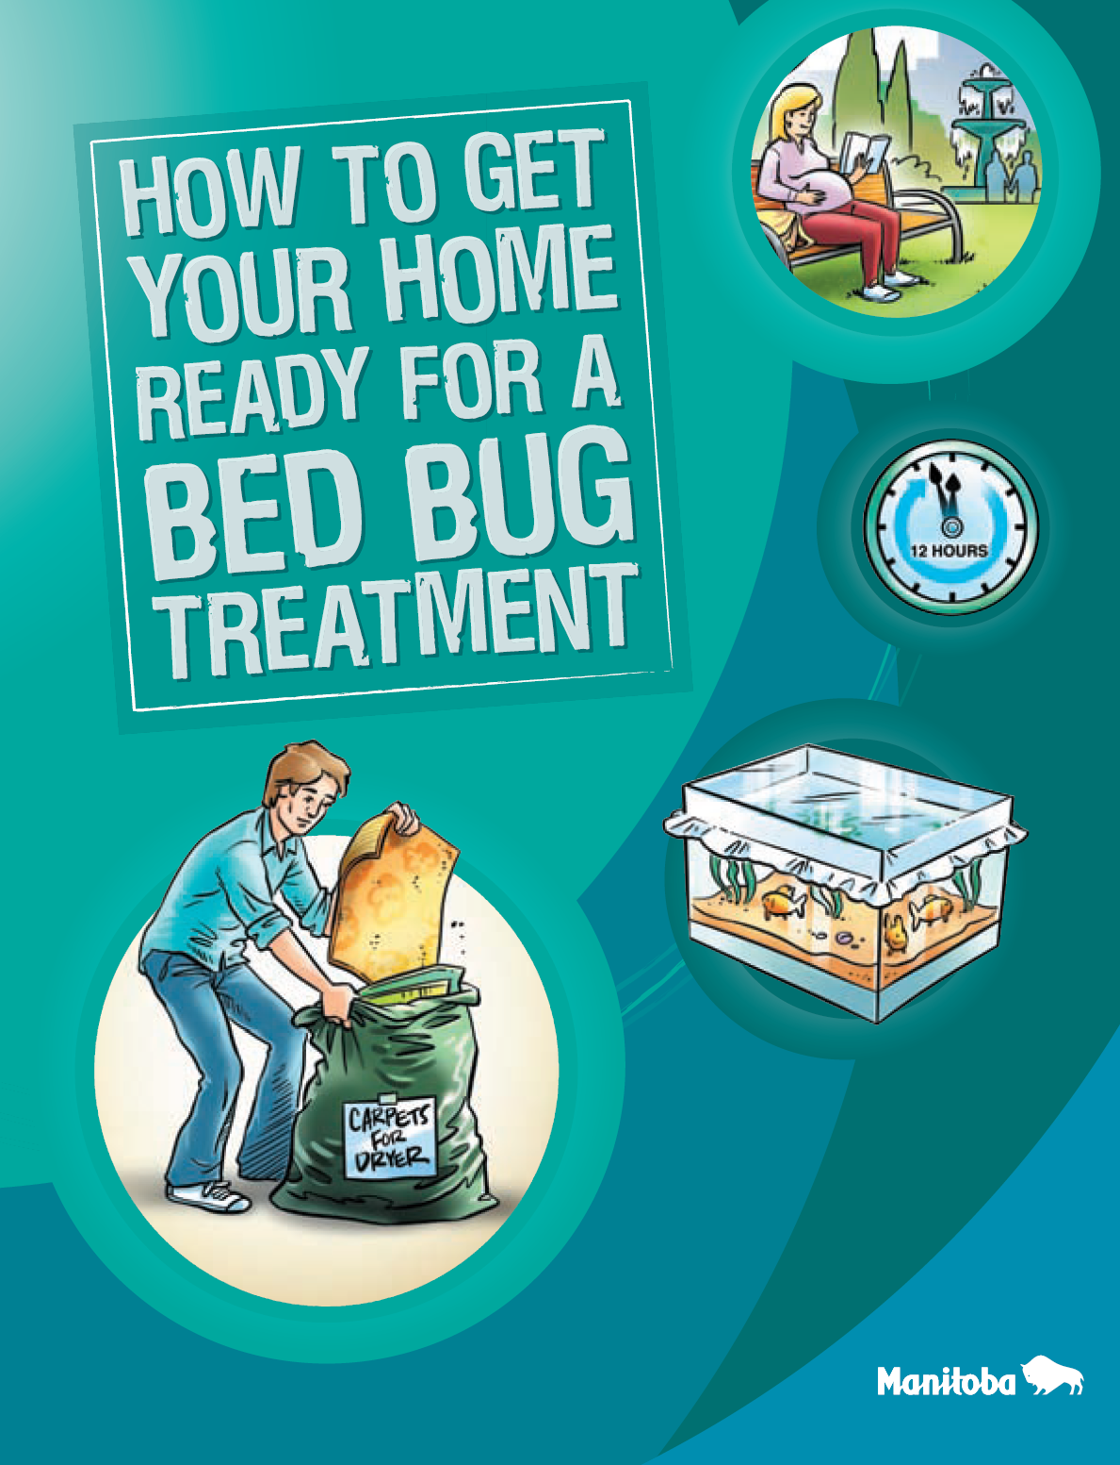

Slide 15
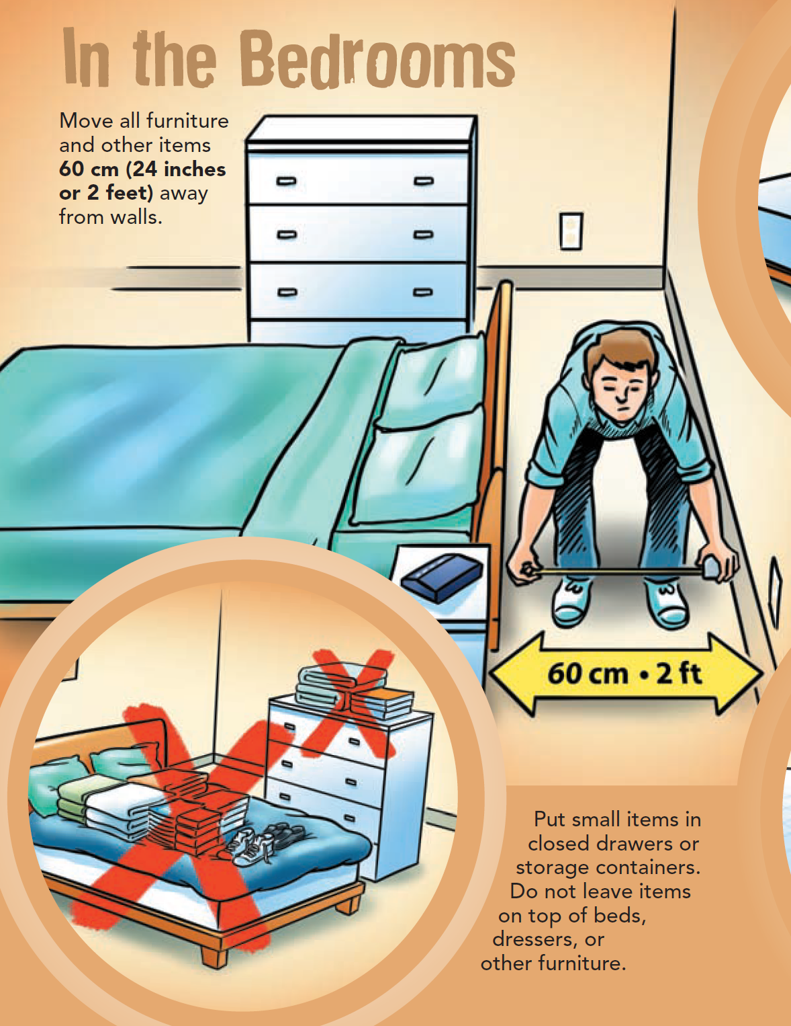

Slide 16
For any Bed Bug related inquiries or
requests for informational materials,
please contact:
1-855-3MB-BUGS
1-855-362-2847
E-mail: bedbugs@gov.mb.ca
Or visit: Manitoba.ca/bedbugs

Slide 17
Contact Information
Jessica Isidro
Program Coordinator
Provincial Bed Bug Strategy
Jessica.Isidro@gov.mb.ca
(204) 786-7183

