Slide 1
COMPLETE Introduction
November 2021

Slide 2
Our Family – Avendra Group of Companies
Powered By
“Delivering Experiences that Enrich and Nourish Lives”
Notes:
As you most likely know and can appreciate, Complete Purchasing Services is part of a larger enterprise.
Here is our family.

Slide 3
LEVERAGE Take advantage of competitive pricing on essential products and services utilizing the worldwide purchasing power of Aramark and the Avendra Group of companies.
Notes:
Speaker’s Notes:
We provide competitive pricing on products and services utilizing the worldwide purchasing power of Aramark and the Avendra Group of comapnies. Our negotiated manufacturer and distributor partner programs are based on safety, quality, service, and price is the foundation of our value proposition. This process defines the best source of supply and best cost in use. We deem these products and services as “Best Value”.

Slide 4
PEOPLE National field-based Account Management team and Client Services teams work collaboratively to assist you and your team members in maximizing the overall benefits of your CPS membership.
Notes:
Speaker’s Notes:
Our national field-based Account Management team as well as our Client Services team work collaboratively to assist clients in maximizing the overall benefits derived from CPS membership. Our people keep us in touch with client and industry issues and requirements, ensuring that our program offering continues to be relevant in an ever evolving business environment.

Slide 5
INNOVATION We take pride in our commitment and ability to consistently focus on the future and develop and implement exceptional programs and services that support our clients in meeting their immediate and long term objectives.
Notes:
Speaker’s Notes:
We take pride in our commitment and ability to consistently focus on the future and to develop and implement exceptional programs and services that support our clients in meeting their immediate and long term objectives. With the right combination of people and technology we will achieve greater levels of effectiveness and productivity on behalf of our clients and our organization.

Slide 6
REACH
‘COMPLETE’ PARTNERS

Slide 7
‘COMPLETE’ Manufacture Partners
Notes:
Speaker Notes:
We are continually adding new products and services to the program. Here are some recent examples of new suppliers that have been added:
blueRover provides a very affordable program for remote wireless monitoring of fridges and freezers inclusive of sensors and software
Tricom is a new partner we added from our sister Company Avendra’s portfolio - they provide third party cleaning and maintenance for common areas
iCheck provides planned maintenance and/or responsive services for a wide range of facility maintenance services.
Exclusive to CPS, our program with Select Wines for Conciere brand offers “Best Value” pricing on an essential lineup of well spirits (gin, whisky, vodka, rum, rye, and triple sec).
Waste Solutions Canada is a consulting company that provides clients from an average savings of 15% to 30% and a dedicated team that helps clients to hold your waste haulers accountable. They negotiate rates, audit monthly invoices to ensure accuracy, as well as handling any day to day waste management issues. This program is entirely results based; using a shared savings model, clients don’t pay unless they save.
Handouts:
Co-branded POS for any suppliers that are relevant to the client

Slide 8
‘COMPLETE’ Distributor Partners
Notes:
Speaker Notes:
We are continually adding new products and services to the program. Here are some recent examples of new suppliers that have been added:
blueRover provides a very affordable program for remote wireless monitoring of fridges and freezers inclusive of sensors and software
Tricom is a new partner we added from our sister Company Avendra’s portfolio - they provide third party cleaning and maintenance for common areas
iCheck provides planned maintenance and/or responsive services for a wide range of facility maintenance services.
Exclusive to CPS, our program with Select Wines for Conciere brand offers “Best Value” pricing on an essential lineup of well spirits (gin, whisky, vodka, rum, rye, and triple sec).
Waste Solutions Canada is a consulting company that provides clients from an average savings of 15% to 30% and a dedicated team that helps clients to hold your waste haulers accountable. They negotiate rates, audit monthly invoices to ensure accuracy, as well as handling any day to day waste management issues. This program is entirely results based; using a shared savings model, clients don’t pay unless they save.
Handouts:
Co-branded POS for any suppliers that are relevant to the client

Slide 9
‘COMPLETE’ Distributor Partners
Notes:
Speaker Notes:
We are continually adding new products and services to the program. Here are some recent examples of new suppliers that have been added:
blueRover provides a very affordable program for remote wireless monitoring of fridges and freezers inclusive of sensors and software
Tricom is a new partner we added from our sister Company Avendra’s portfolio - they provide third party cleaning and maintenance for common areas
iCheck provides planned maintenance and/or responsive services for a wide range of facility maintenance services.
Exclusive to CPS, our program with Select Wines for Conciere brand offers “Best Value” pricing on an essential lineup of well spirits (gin, whisky, vodka, rum, rye, and triple sec).
Waste Solutions Canada is a consulting company that provides clients from an average savings of 15% to 30% and a dedicated team that helps clients to hold your waste haulers accountable. They negotiate rates, audit monthly invoices to ensure accuracy, as well as handling any day to day waste management issues. This program is entirely results based; using a shared savings model, clients don’t pay unless they save.
Handouts:
Co-branded POS for any suppliers that are relevant to the client

Slide 10
We Support Local & Canadian Businesses
A Few Local Supplier Examples…
A Few Canadian Supplier Examples…
Notes:
Speakers Notes:
We are proud to work and promote several local and Canadian based solutions providers as part of the COMPLETE Program offering. Here are a few examples of locally-based and Canadian suppliers who are a part of our current program offering.

Slide 11
Simplified Sign On
One login to access…
eCPS Purchasing
eCPS Marketplace
COMPLETE Dining Program
COMPLETE Education Program
eCPS Instructor
And much more!
Notes:
Speaker Notes:
Everyone has so many usernames and passwords to remember these days and we wanted to ensure that your experience with eCPS and all of it’s invaluable tools and resources are easy to access for our members. Inasmuch, you only have 1 username and password to remember to login. If you forget your password, there is a link you can click to reset it, or you can call eCPS Client Services for assistance.
Handout:
- Keeping it Simple with eCPS
- Keeping it Simple with eCPS Purchasing

Slide 12
eCPS – Home Page

Slide 13
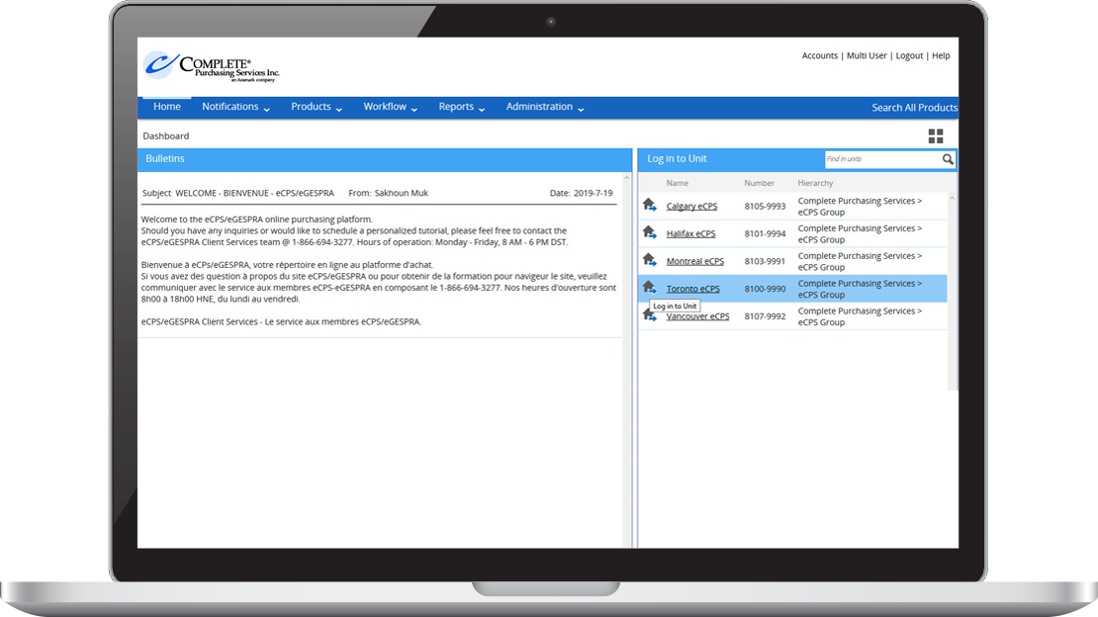
Knowledge IS Power with eCPS Purchasing
Notes:
Speaker Notes:
eCPS Purchasing has been designed to make the ordering and inventory management process easier and faster while promoting best practices, and to provide users with the information they need to make the right choices for their business. With a robust offering of simple-to-use features and tools, we truly make business easy.
Would you like to have the ability to quickly and easily obtain reports and information on how much your sites are spending, what they are ordering, and what is in their inventory? What about if a staff member is suddenly unavailable to place their orders due to an emergency, termination, etc. Would you like to have the ability to step in and ensure that everything continues to move forward as expected?
The eCPS Purchasing application is a powerful tool that provides your dedicated head office administrators with access and visibility to all of the above and more for your locations. In this screenshot is an example of what an administrator would see if they wanted to login to a location to view purchases, reports, or impersonate to place an order.

Slide 14
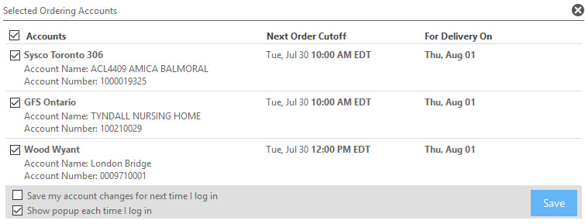
Multi-Distributor Access Easily create and place orders from multiple distributors.
Notes:
Speaker Notes:
eCPS Purchasing provides users with access to multiple suppliers and distributors. This means that once trained in eCPS Purchasing, users can easily create and place orders from multiple distributors. In addition, if your home decides to switch distributors or only use one distributor, all is not lost. There is no need to re-learn a new system and we can help you manage your shopping lists, templates, etc.

Slide 15
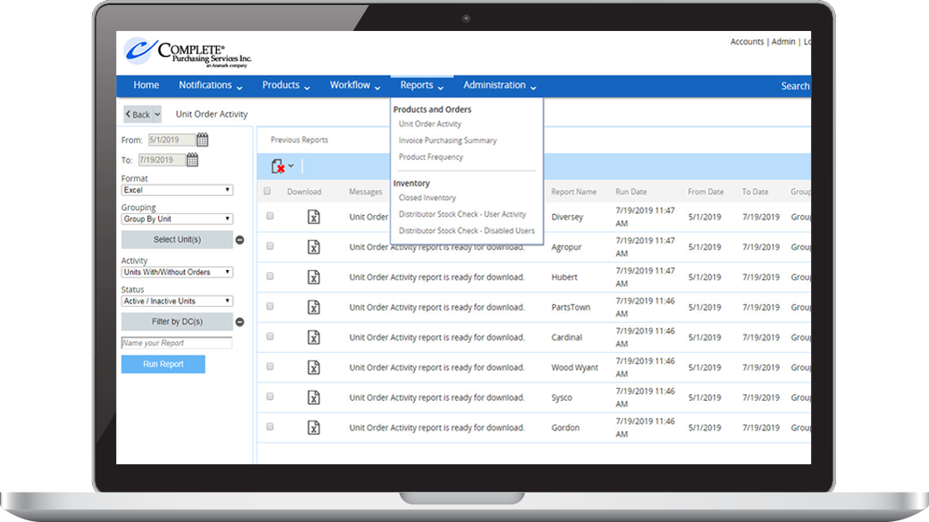
Reporting Feature “Information is the resolution of uncertainty.” Claude Shannon
Notes:
Speaker Notes:
Keep a close eye on your business expenditures with the eCPS Purchasing reporting features. As a head office admin you can quickly and easily obtain reports on all, some, or individual locations. Reports can include unit order activity, product frequency by brand or group, purchase frequency, invoice purchase summary, inventory, and much more.
Handout Notes:
Provide samples of reports:
If the client is not already using eCPS Purchasing provide report samples provided as a handout
If a client is using eCPS Purchasing, provide sample reports from eCPS Purchasing to demonstrate report types that they can access

Slide 16
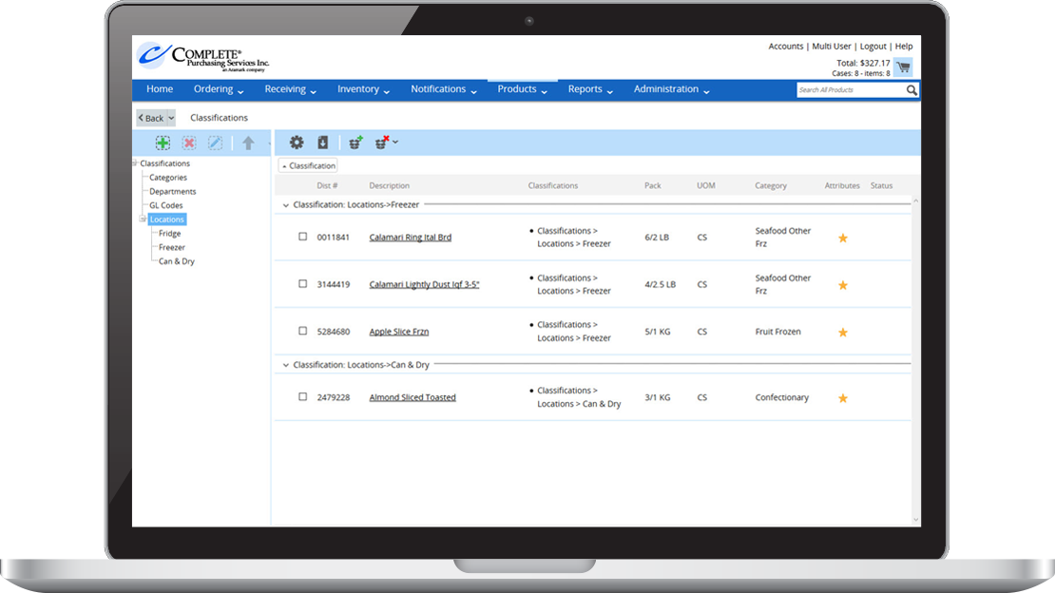
Integrated Inventory
Staying on top of products on-hand and your budget has never been easier!
Notes:
Speaker Notes:
Taking inventory is considered a best practice, however we appreciate how daunting a task it can be. The eCPS inventory management feature has been designed to make the process easier for users. Items are automatically added to the master inventory list as soon as items are ordered. By using the inventory function, users are able to better control and manage their costs. Users can also create custom barcodes for all items, on and off catalogue, and organize their inventory lists based on their setup.
*SHA Barcoding – lean / kan ban cards / investment made to provide a solution

Slide 17
eCPS MenuBuilder An easy and cost effective way to create health and happiness for residents while alleviating unnecessary extra work for staff.
Notes:
Speaker’s Notes:
eCPS MenuBuilder has been created for CPS member’s as a free tool to help operators create a menu that elevates the resident dining experience while helping to ensure that all operational requirements have been met such as budget, nutritional requirements, resident taste preferences, and Canada’s Food Guide. This flexible and easy-to-use program has evolved based on the expressed needs of CPS member users. Used in conjunction with a COMPLETE Menu, users can customize their menu based on resident feedback by substituting or customizing existing recipes, or adding in their own. With a deep understanding and appreciation of how complicated it is to plan a menu, this powerful tool used in conjunction with a COMPLETE base menu helps operators get a head start on planning and executing their menu. We also want to mention that it also includes cool features such as the ability to share your completed menu with others in your group affiliation (e.g. chain or health region) to help further save the time and effort that it takes to plan and execute a menu. And of course these shared menus can be further customized by the various locations.

Slide 18
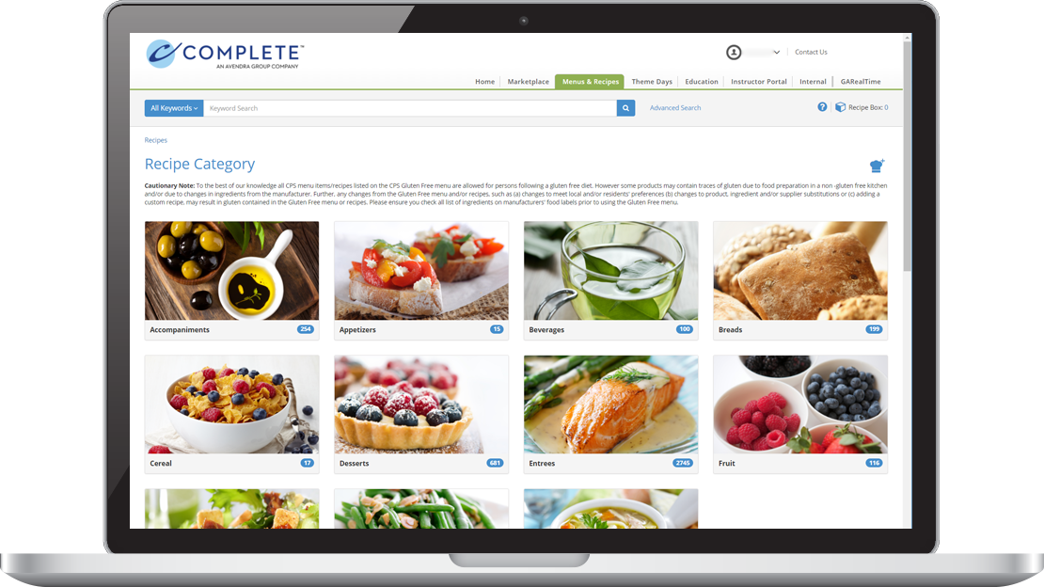
COMPLETE Recipes Standardized, creative, delicious, and flexible…your recipe for success starts with all of the right ingredients.
Notes:
Speaker’s Notes:
The COMPLETE recipe database provides CPS members with access to over 5,000 recipes. Our recipes include many traditional and comforting Canadian favourites in addition to new and innovative recipes that we believe your residents would enjoy. Our recipes can be customized to suit the needs and taste preferences of your residents, scaled for production so that you are creating an appropriate number of meals, and you also have the ability to create and add in your own recipes. We always want to remind our member’s to think about the little things that can have a big impact on resident experience; for example you may want your weekend cooks to prepare a meal the same way if would have been prepared during the week. Our recipe database can be a solution to that need and help with other scenarios such as staff absenteeism (e.g. vacations, turnover, etc.).

Slide 19
REACH
‘COMPLETE’ EDUCATION
Notes:
Close off w/ Education

Slide 20
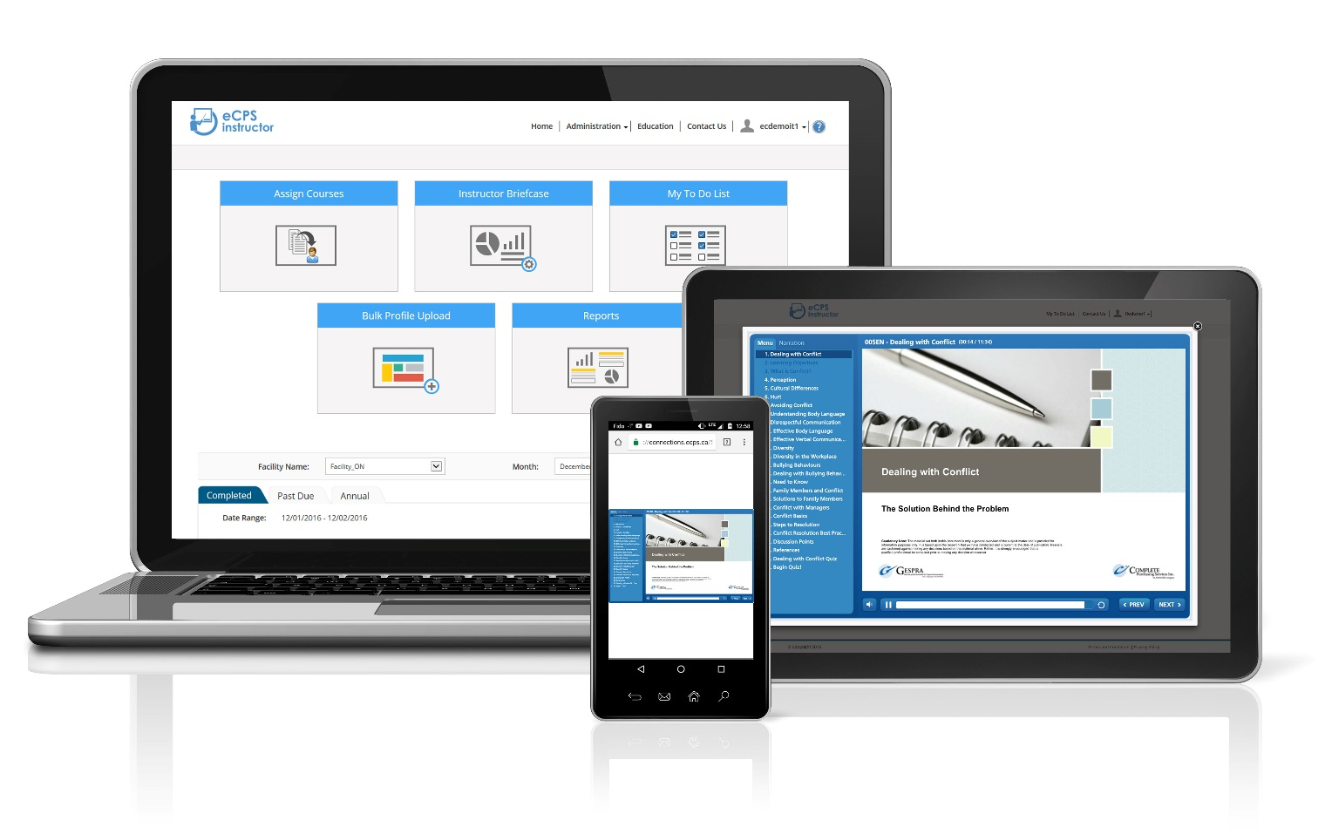
eCPS Instructor… Staff Training Made Easy from a Distance!
Plan the training schedule for all staff members.
Assign specific or custom training modules, videos, or documents.
Track the progress of each employee.
Notes:
Speaker’s Notes:
eCPS Instructor is truly staff training made easy. This FREE (yes free) offering is designed to provide managers with an easy-to-use application to help them plan, assign, and track the training of front line staff. Managers can assign any of the CPS in-service modules (we have over 75 to choose from), a YouTube link, or home policy document. This application is the perfect tool for monthly staff in-services, progressive discipline, or new hire training. In addition, staff can choose how they want to receive their training notices, by email, or text, and the trainings can be completed from a tablet, mobile phone, or computer.
COVID friendly – distance learning . Implemented a few years ago but COVID has accelerated the interest
Handout:
eCPS Instructor companion guide
Keeping it Simple with eCPS Instructor

Slide 21
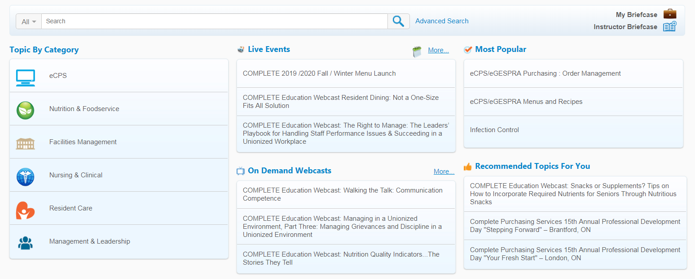
The COMPLETE Education Program... An opportunity for everyone to learn, share, and grow!
Notes:
Speaker’s Notes:
One of the cornerstone offerings of a CPS membership is the COMPLETE Education Program. We believe in the importance of continuous learning and its ability to have a positive impact on any organization in terms of employee engagement, resident / client satisfaction, processes & procedures, and human understanding. As such, we proudly offer a wide variety of educational opportunities for everyone from front-line staff to managers and above. Our offering includes live conferences and events, webcasts, online in-service modules, and a program where managers can plan, assign, and track the training of staff members called eCPS Instructor.

Slide 22
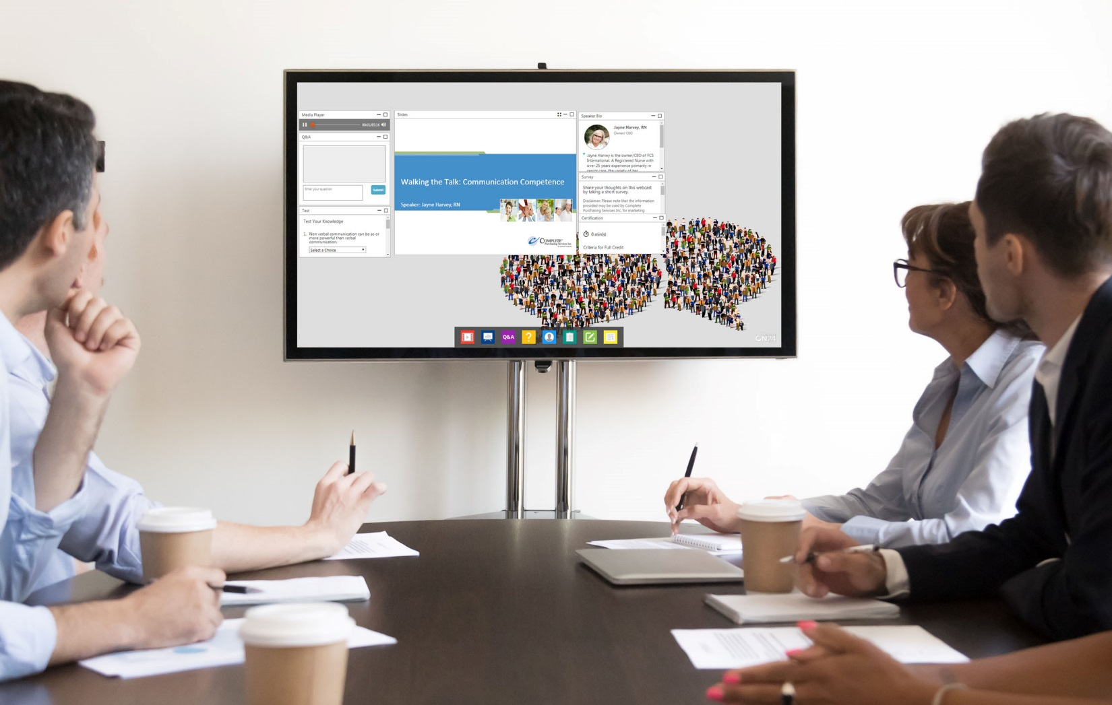
COMPLETE Webcast Series Cutting-edge education (in one hour or less) from the comfort of your office.
Notes:
Speaker Notes:
The COMPLETE Webcast series features a wide range of cutting-edge topics. Each webcast is approximately 60 minutes, with 45 minutes (or less) for the presentation and some time for live Q & A. Perfect for staff training and meetings, you can participate in these educational opportunities from comfort of your workplace. And if you can’t attend the live event, watch it OnDemand through eCPS.ca. I also want to mention that participation in these webcasts have been accredited for CSNM CE points if watched live or within 1 week of the live broadcast.
Handout:
Provide copy of Webcast Series overview for participants.

Slide 23
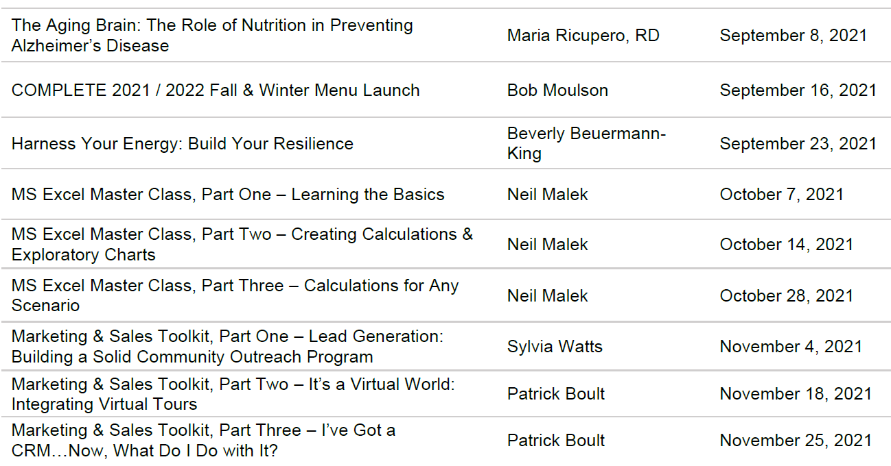

Slide 24
COMPLETE Professional Development Days Join us to learn from top-quality speakers on topics and ideas perfect for anyone in a management position.
Proprietary & Confidential: The information contained herein is strictly confidential and is intended for internal review by the intended parties only. This presentation may contain general program overview for informational or marketing purposes only, is non-binding and is subject to change by Complete Purchasing Services Inc. at its sole discretion.
Notes:
* Dedicated virtual room?
Speaker’s Notes:
The COMPLETE Professional Development Days are 1-day conferences feature speakers and topics perfect for anyone in a management position. In addition, participants can learn about new products & services during the supplier showcase luncheon. Our goal in hosting these events is to ensure that all managers have the opportunity to participate in experiential learning that will enhance their professionalism, knowledge, and help them to create a positive work environment for the people whom they work with and serve. Other benefits include growing your professional network and having fun. If your group would like to bring 8 or more people, please connect with us to reserve seating for your group. One last thing to note, these events have been accredited for CSNM CE points available.
UPDATE for 2021: While we are planning on hosting live events in the fall, it should be noted that we may be pivoting these events to a virtual format if hosting live events is unsafe to do so. We will know by May of 2021 if we are able to go forward with a live event or not.
Handout:
Upcoming local Professional Development Day invitation

Slide 25
Education

Slide 26
Questions? Barb Pearce (204) 223-8047 pearce-barbara@avendra.com

